Slide 1
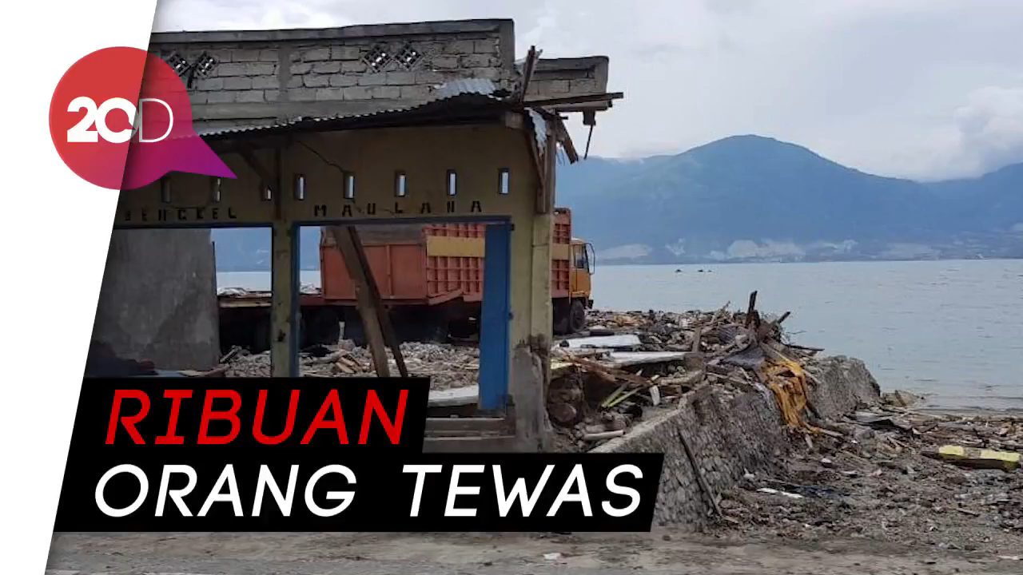

Slide 2
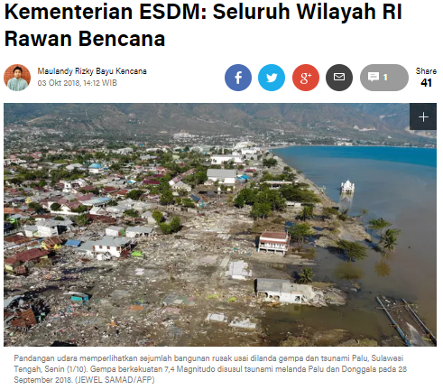
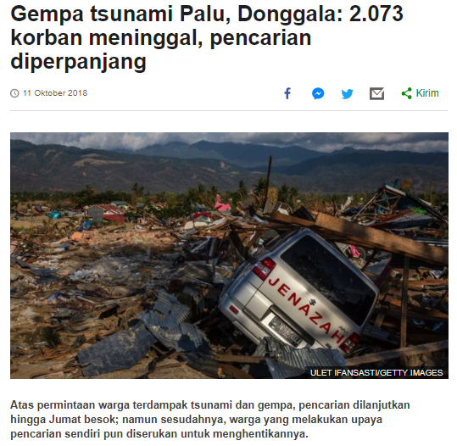
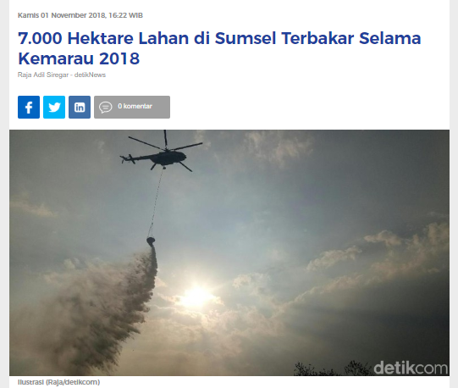
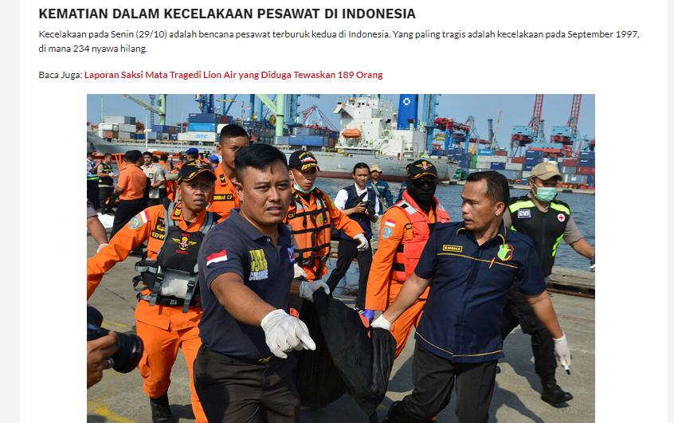
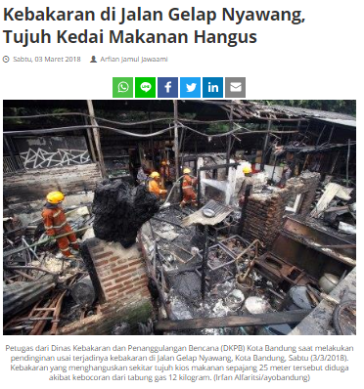

Slide 3
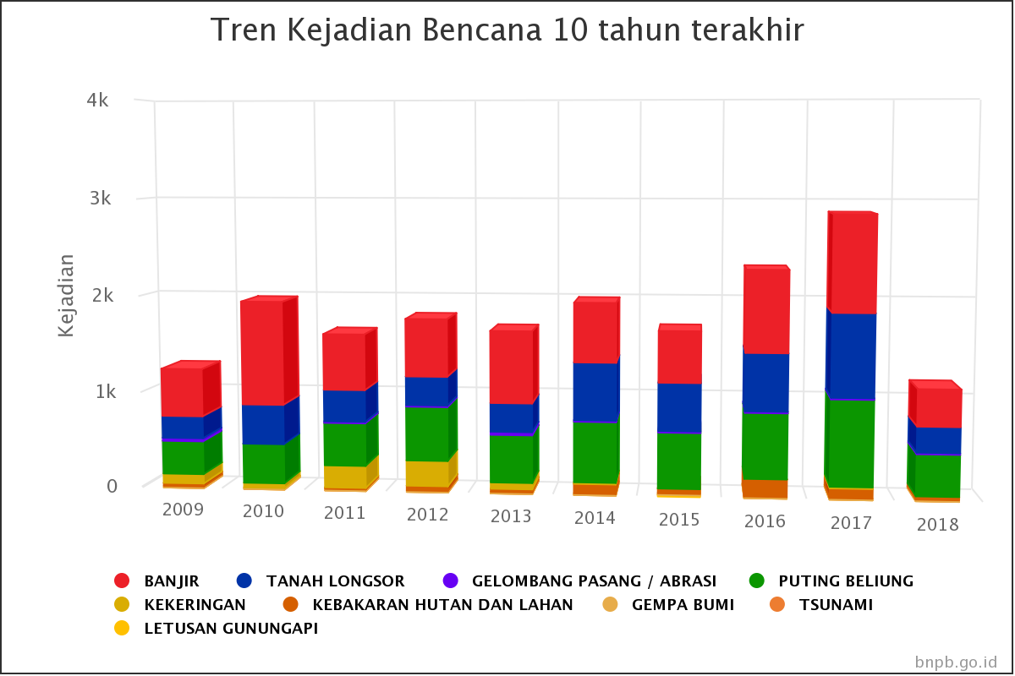

Slide 4
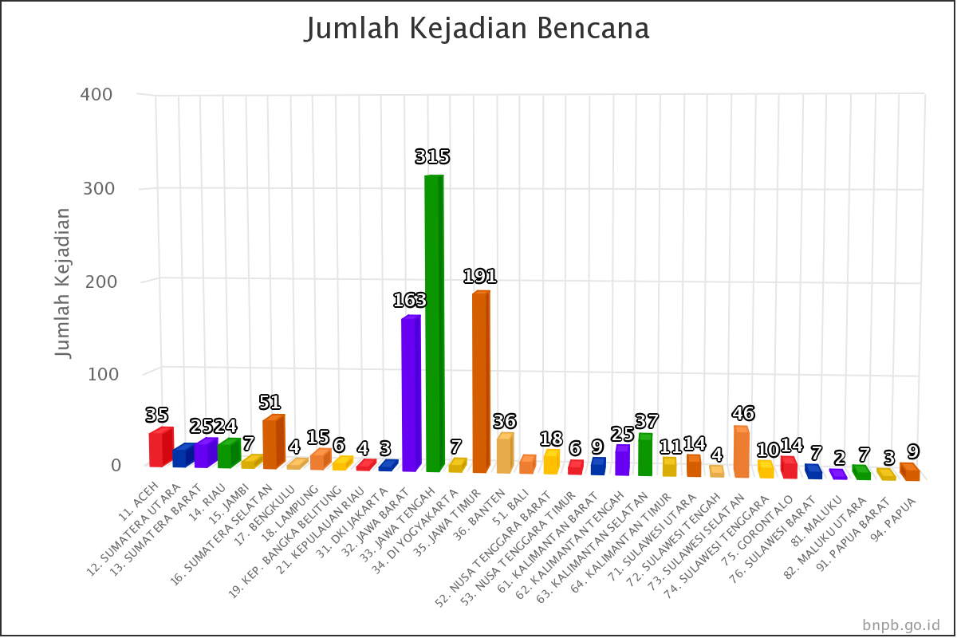

Slide 5
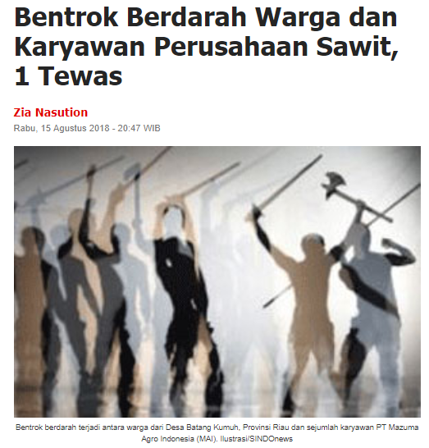
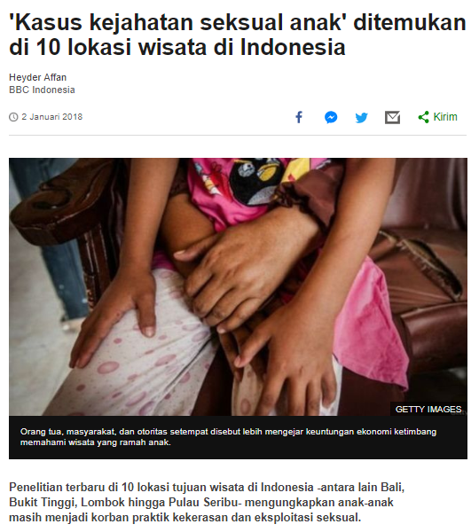
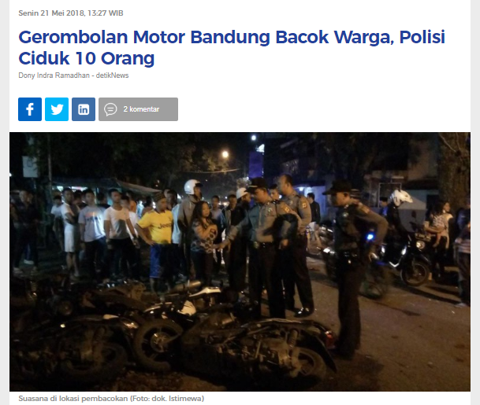

Slide 6
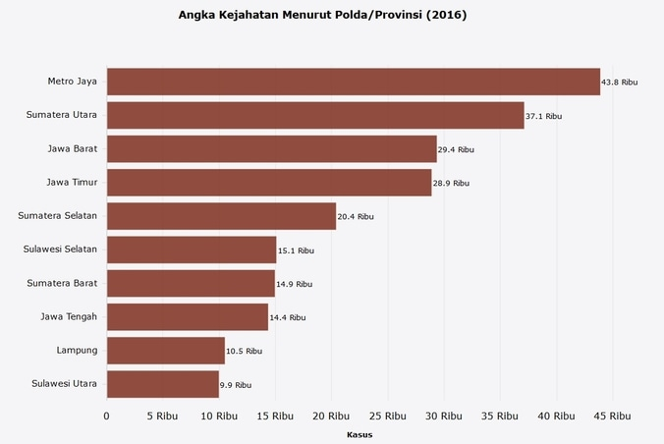

Slide 7

- Heroes

Slide 8
“Andro Emergency”
Permadi & Azhar
Telecommunication Engineering
ITB ‘15

Slide 9

What is “AndroEmergency” ?
Is a software to help people connect to the polices, ambulances, rescuers, and so on.

Slide 10
What’s the Features?

Slide 11
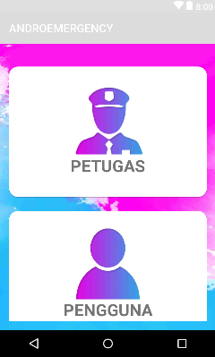
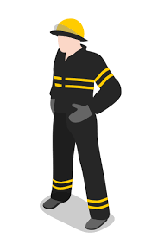
User
Worker

Slide 12

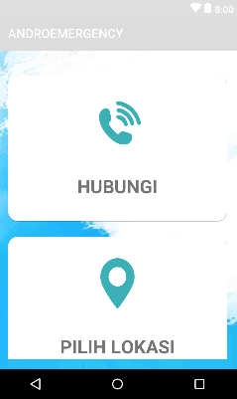
Call
Maps

Slide 13
Team Work
 | Azhar | Permadi
Register & Login | 1 | 0
Call | 0 | 1
Firebase | 1 | 0
Maps | 1 | 1
Combining Code | 1 | 0
Mock-Up Apps | 1 | 1
Ppt | 0 | 1

Slide 14
Thanks!
Any questions?
You can find us at:
permadi.tp97@gmail.com
azharnurkemal97@gmail.com

